Slide 1
What makes sense in biology?
Daniel Garza
(KU Leuven, Belgium & Balance of the Microverse, Germany)

Slide 2
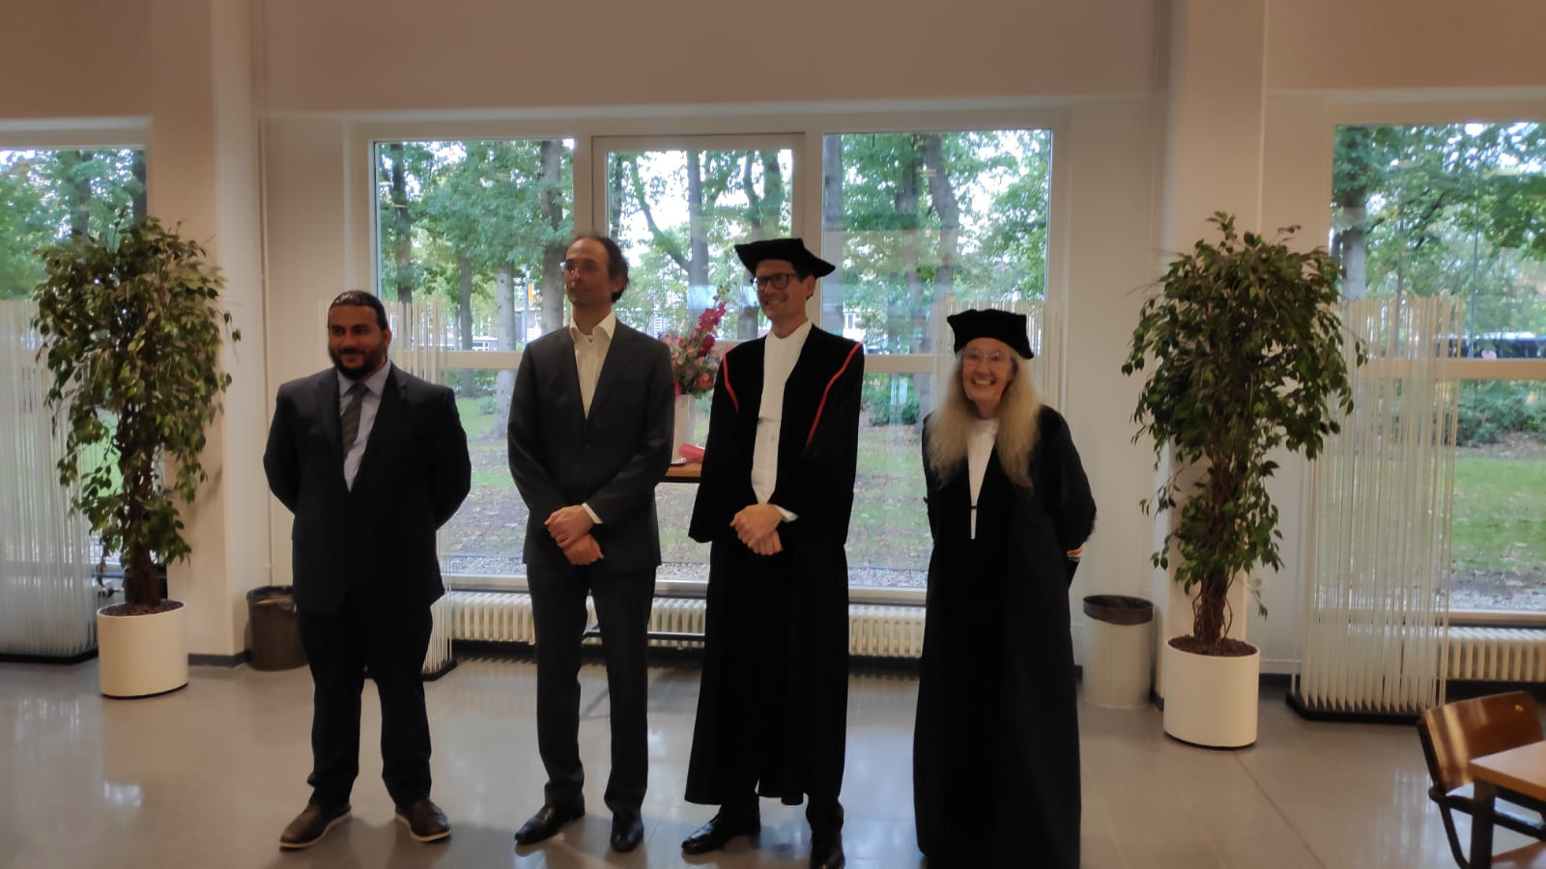
Prof. Bas Dutilh
Prof. Martijn Huijnen
Prof. Paulien Hogeweg

Slide 3
Prof. Bas Dutilh
Prof. Martijn Huijnen
Prof. Paulien Hogeweg

Slide 4
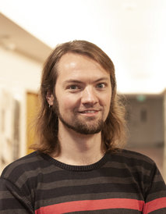
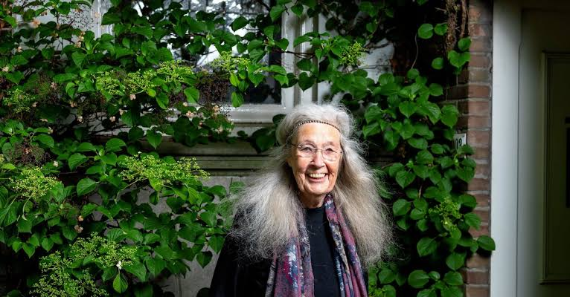
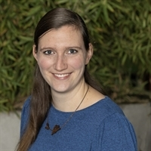
Dr. Bram Van Dijk
Dr. Hilje Doekes
Prof. Paulien Hogeweg
“Nothing in biology makes sense except in the light of evolution”

Slide 5
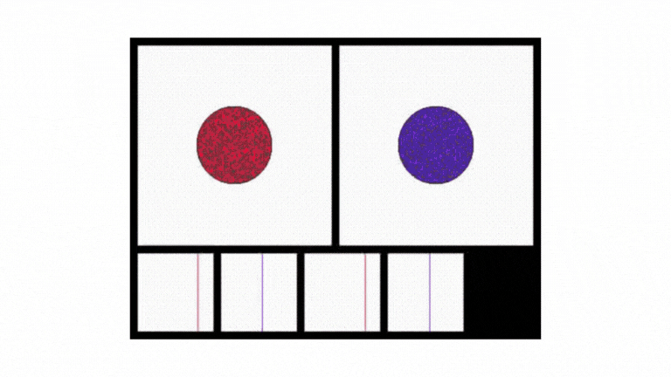

Dr Bram Van Dijk
Dr Hilje Doekes
Prof. Paulien Hogeweg
“Nothing in biology makes sense except in the light of evolution spatial structure”

Slide 6
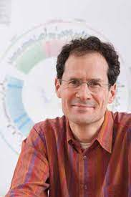
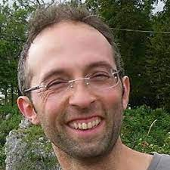
Prof. Bas Dutilh
Prof. Martijn Huijnen
“Nothing in biology makes sense except in the light of evolution spatial structure”

Slide 7
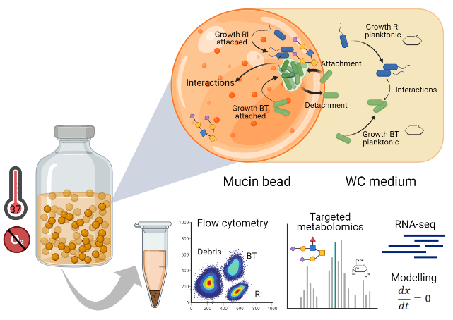
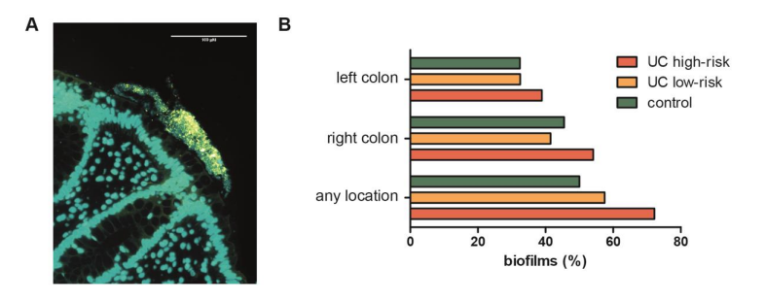
Prof. Bas Dutilh
Prof. Martijn Huijnen
“Nothing in biology makes sense except in the light of evolution spatial structure data”
Bruggeling, Te Groen & Garza et al. J Crohns Colitis (2023)
Liu & Garza et al. ISME J (2023, in press)

Slide 8
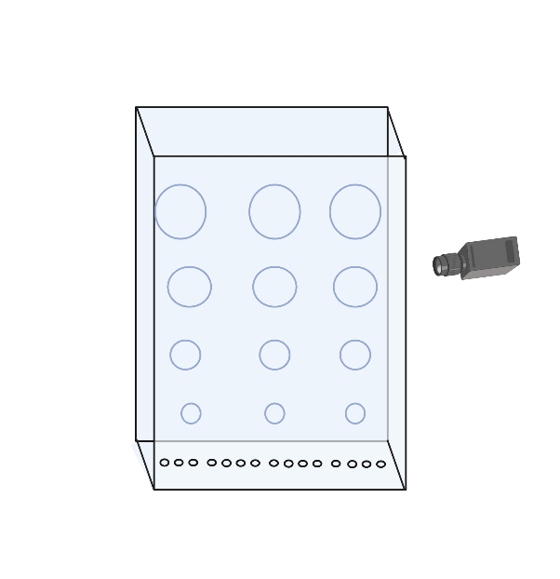
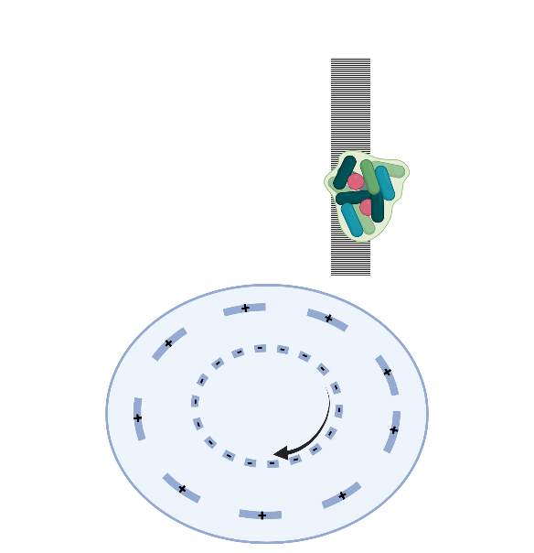
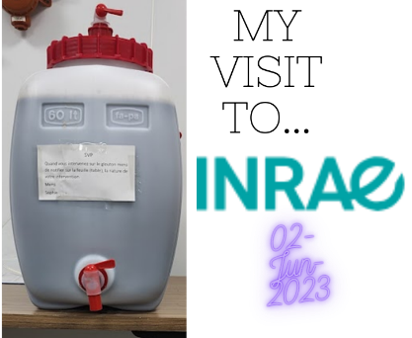
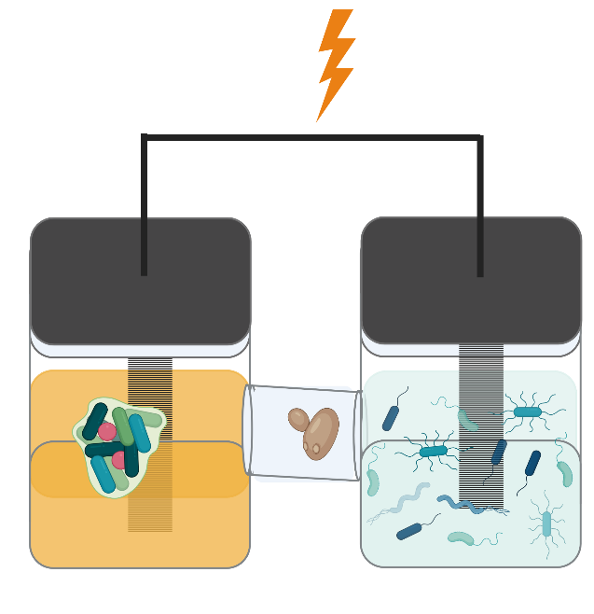
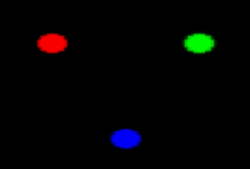
Develop mathematical frameworks that connect the dots between the spatial distribution of environmental factors and the structure, function, and control of microbial systems
Organize a theoretical and practical forum with invited authors of key studies, who can also provide a hands-on tutorial for the exchange of knowledge

Slide 9
“Nothing in biology makes sense except in the light of evolution spatial structure data”

Slide 10
“Nothing in biology makes sense except in the light of evolution spatial structure data mechanisms”

Slide 11
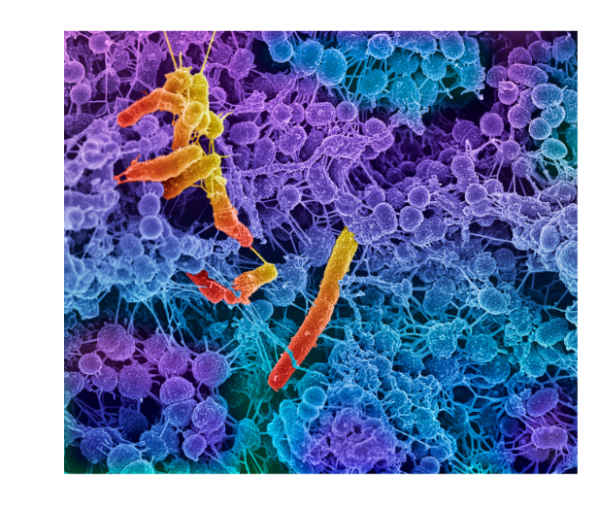
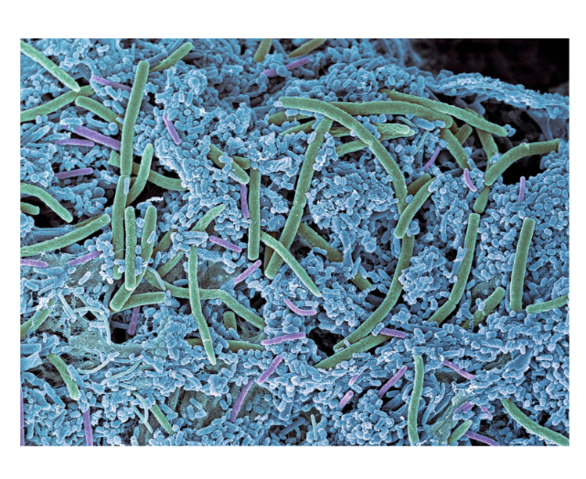
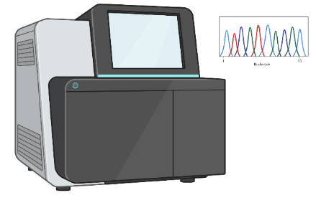
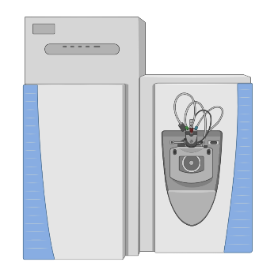
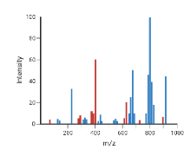
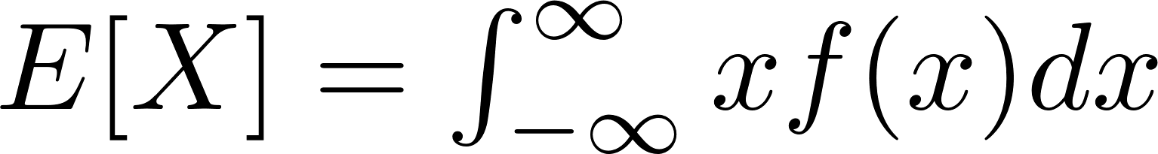
Is my community stable?
Is it performing my desired function?
Will it shift to an alternative state?
How can I optimize its function?
DNA sequencing
metabolomics

Slide 12
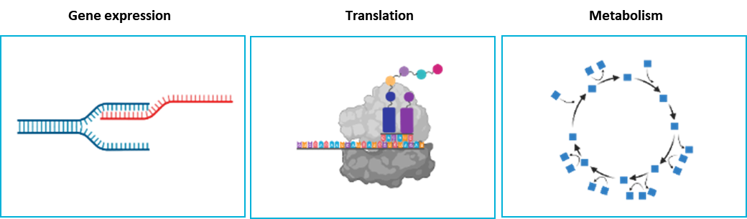
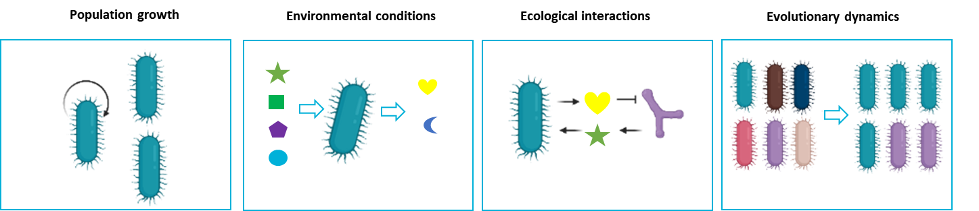
Is my community stable?
Is it performing my desired function?
Will it shift to an alternative state?
How can I optimize its function?
Cellular level
DNA sequencing
Eco-evolutionary level
metabolomics

Slide 13
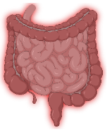
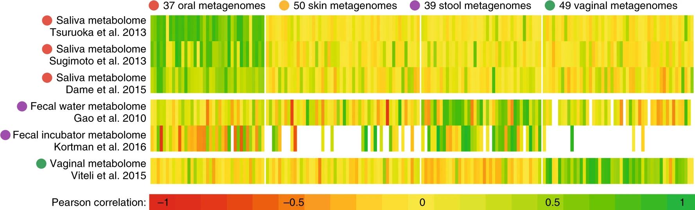

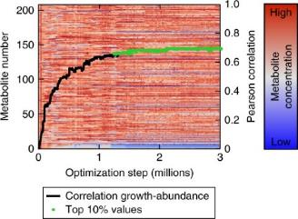
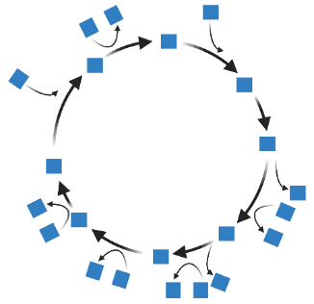





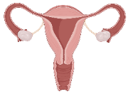
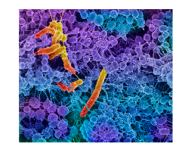
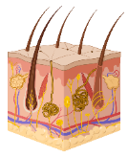

Garza et al. Nat Microbiol 2018

Slide 14
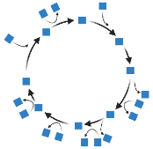
Is my community stable?
Is it performing its desired function?
Will it shift to an alternative state?
How can I optimize its function?

Slide 15
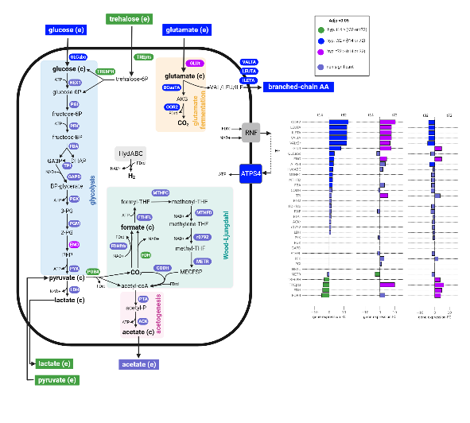

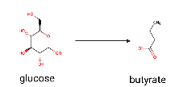
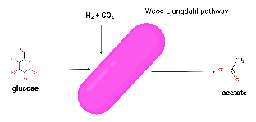
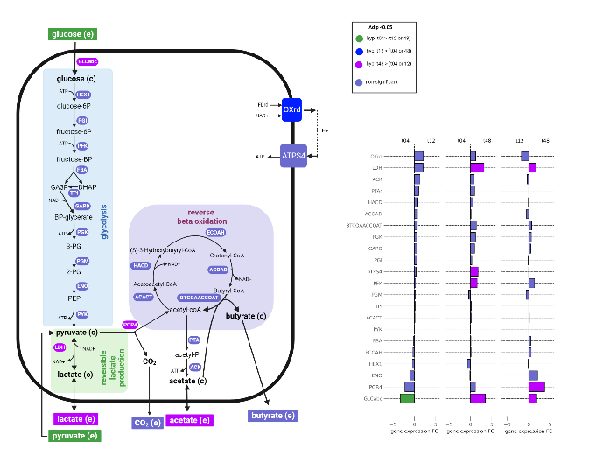
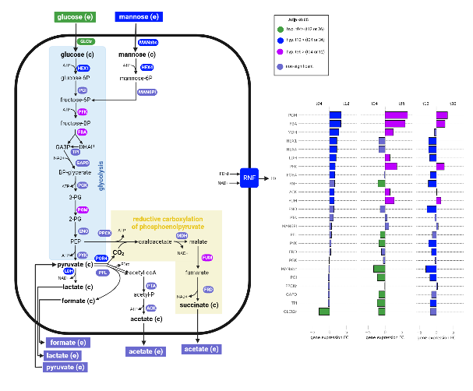
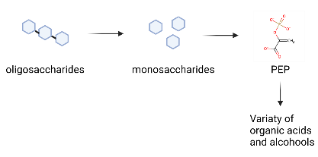

Blautia hydrogenotrophica (Bh)
Roseburia intestinalis (Ri)
Acetogen
Butyrate producer
Bacteroides thetaiotaomicron (Bt)
Primary fermenter
Multi-omics map
System of ODEs

Slide 16
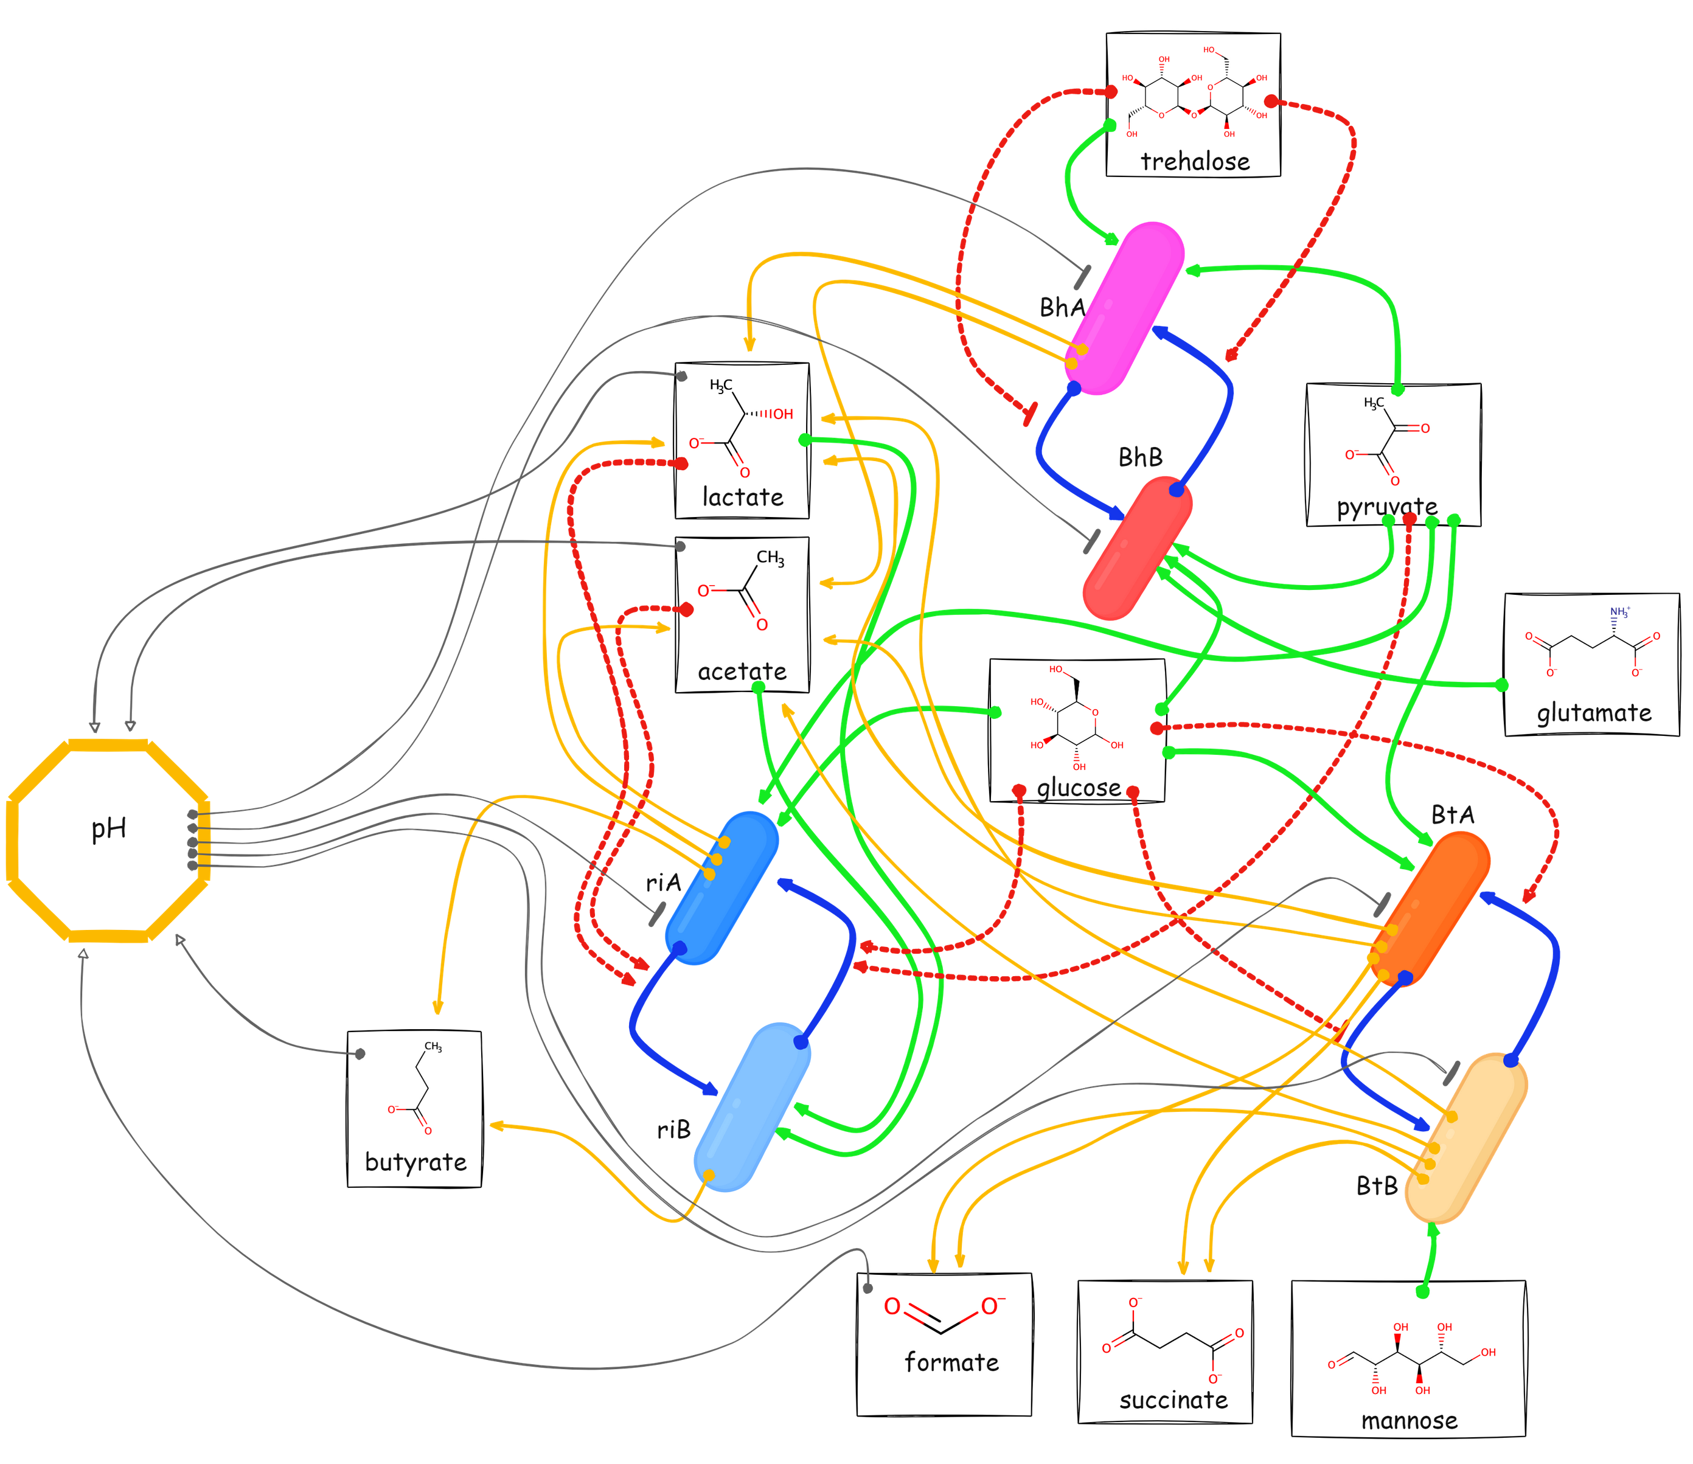
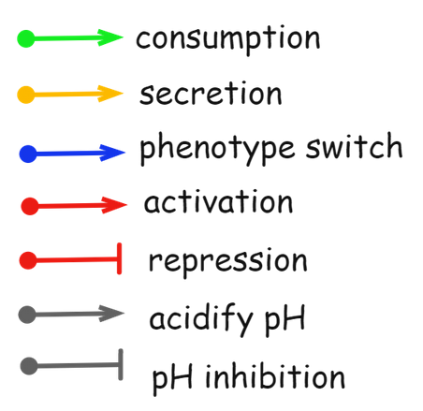
Mechanistic model

Slide 17
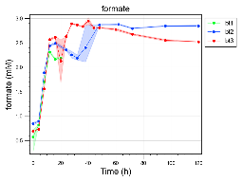
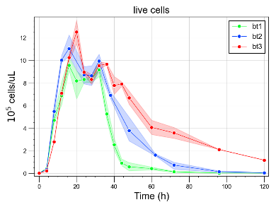
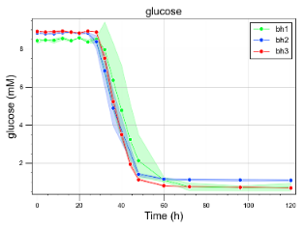
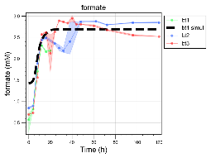
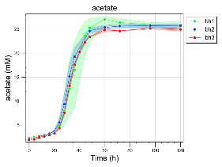
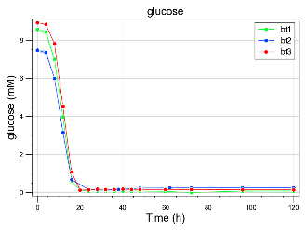
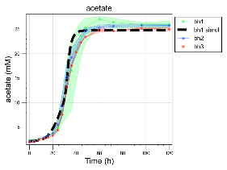
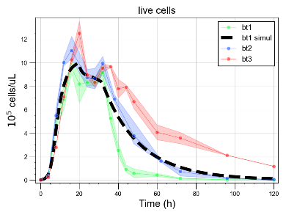
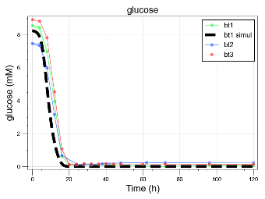
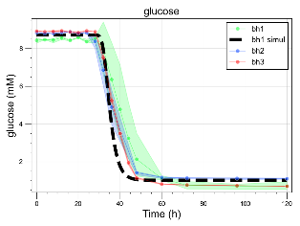
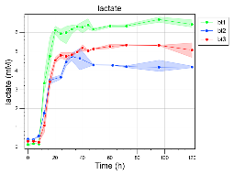
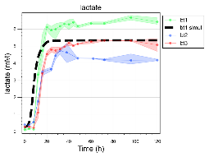
































Growth
Nutrient uptake
Metabolic by-products
pH

Slide 18


Steady-state concentrations
(divided by the row max)
Simulate different dilution rates in a chemostat

Slide 19







faster dilution rate
slower dilution rate
Tipping point

Slide 20


Slide 21


Slide 22






Slide 23
spatial structure
data
mechanisms
a clear communication of results
biology
Ecology
evolution
Nothing in
makes sense, except in the light of

Slide 24




Acknowledgements
Lab of Microbial Systems Biology
Prof. Karoline Faust
Dr. Bin Liu
ETH Zürich
Dr. Annelies Geirnaert
Raes Lab
Dr. Emma Hernandez-Sanabria
Leen Rymenans
Bernaerts Lab
Prof. Kristel Bernaerts
Kenneth Simoens
Université Libre de Bruxelles
Prof. Didier Gonze
VEO group
Prof. Bas Dutilh
Aristeides Litos
Funding
QUESTIONS WELCOME!

